Slide 1
AWS
Elastic beanstalk
EC2

Slide 2
In cloud computing, the word "cloud" (also phrased as "the cloud") is used as a metaphor for "the Internet," so the phrase cloud computing means a type of Internet-based computing, where different services —including servers, storage and applications — are delivered to an organization's computers and devices through the Internet.
Cloud computing is the on-demand availability of computer system resources, especially data storage and computing power, without direct active management by the user. The term is generally used to describe data centers available to many users over the Internet. Large clouds, predominant today, often have functions distributed over multiple locations from central servers
Clouds may be limited to a single organization (enterprise clouds^{[1][2]}), be available to many organizations (public cloud), or a combination of both (hybrid cloud).
Cloud computing relies on sharing of resources to achieve coherence and economies of scale.

Slide 3
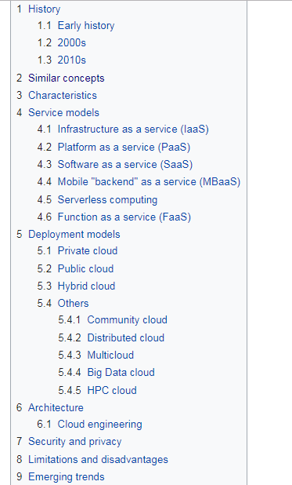

Slide 4
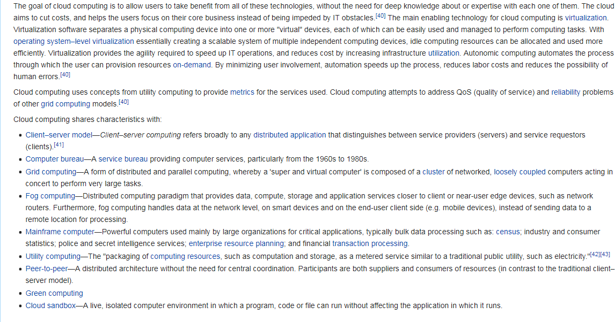

Slide 5
Steps to Setup Env. & deploying App on AWS
steps to create parent
1. create elastic beanstalk(select tomcat env.)
2. configure route53 (complete the right mapping of 4 parameters ns, soa(default), 2 alise mapping )
3. load balance application to enable https connection
4. create certificate in ACM
5. add rule for https 443 in security group against ELASTIC BEANSTALk created... record
6. add listener for https 443 in LOd balancer & upload certificateof parent
steps to create child/subdomain
https://www.youtube.com/watch?v=nlff6mnmMeM
1. create elastic beanstalk
2. configure route53
3. load balance application to enable https connection
4. use certificate created in step 4 of parent
5. add rule for https 443 in security group against ELASTIC BEANSTALk created... record
6. add listener for https 443 in LOd balancer & upload certificateof parent

Slide 6
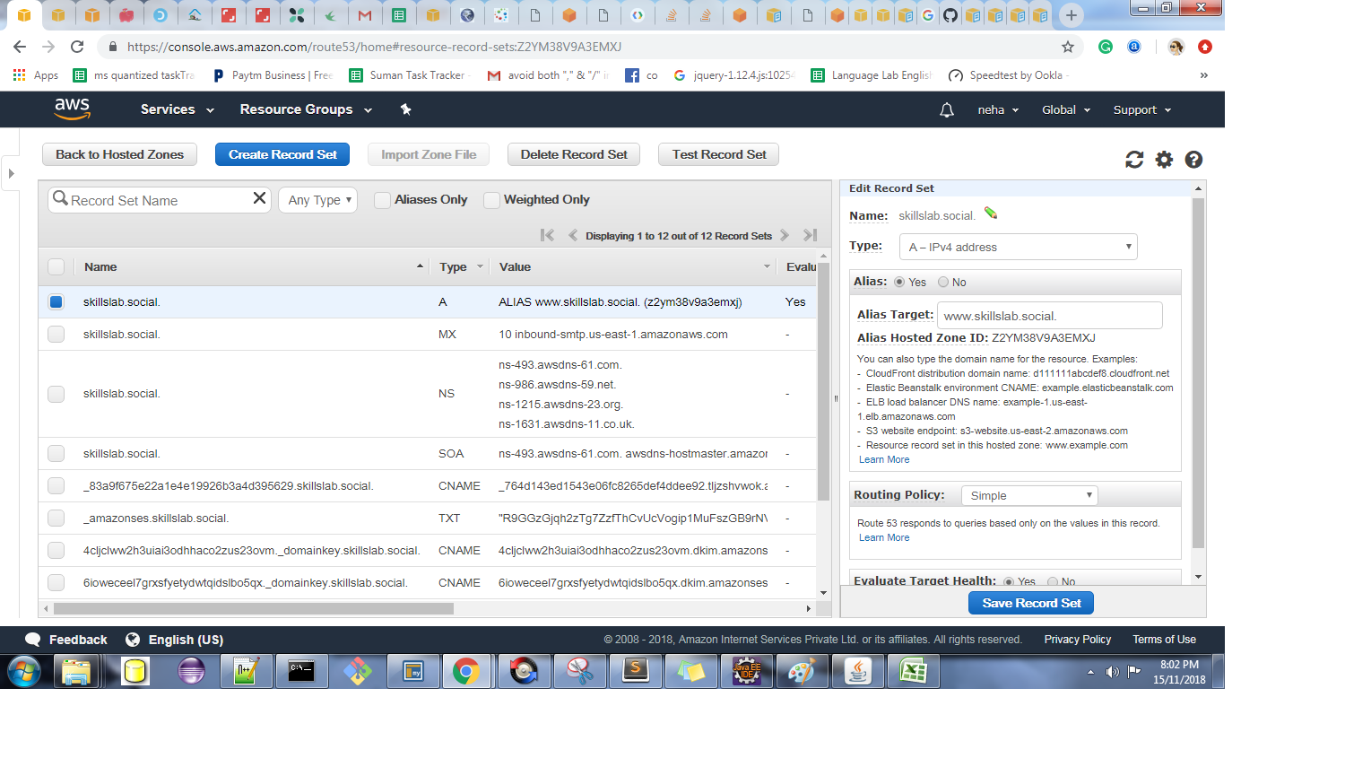

Slide 7
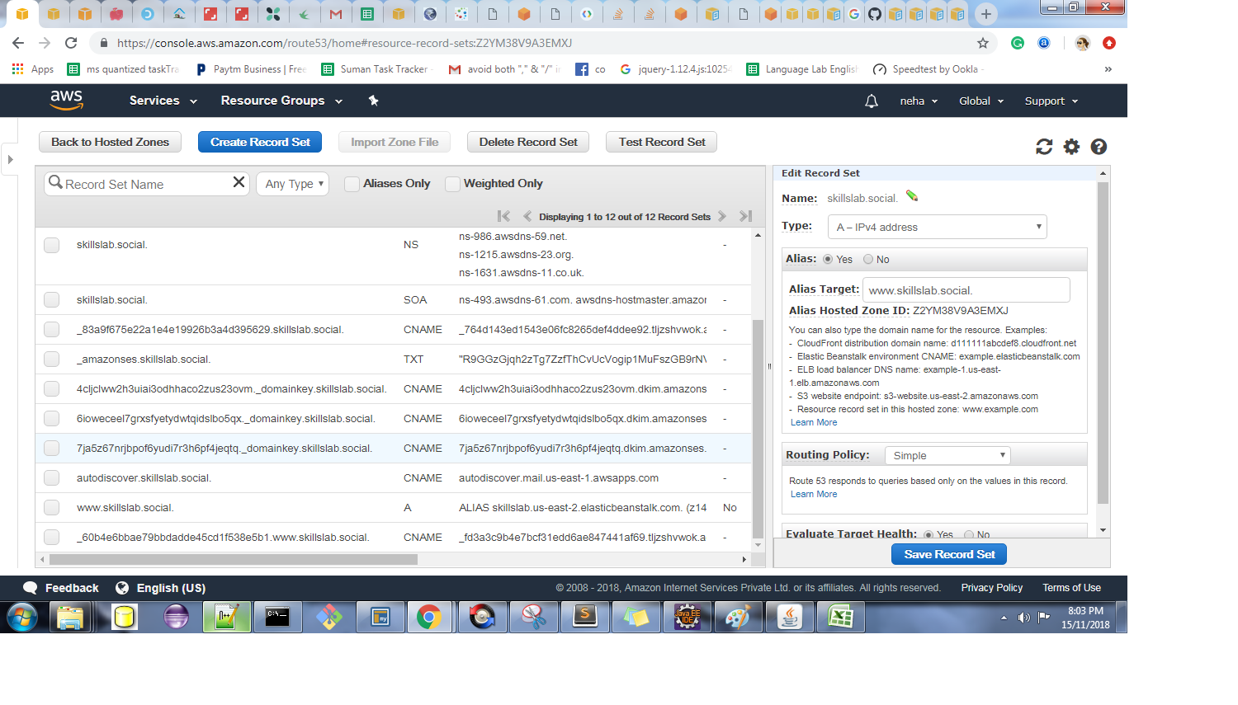

Slide 8
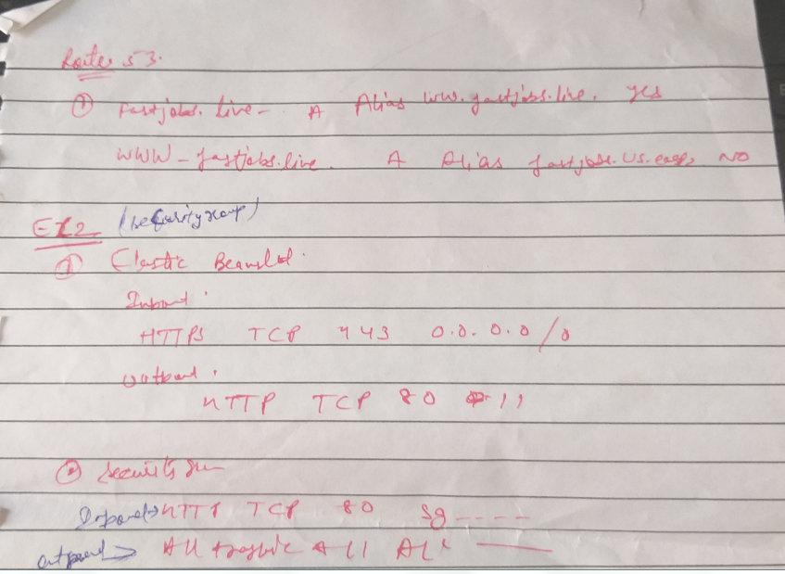

Slide 9
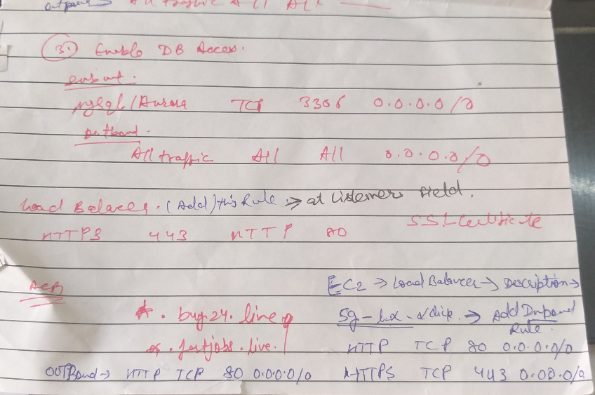

Slide 10
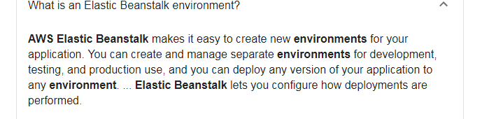
Is Elastic Beanstalk PaaS?
Key Features: AWS Elastic Beanstalk. The PaaS offering was developed byAmazon and helps developers deploy applications on AWS cloud. Elastic Beanstalkautomatically handles every aspect in the cloud upload, including capacity provisioning, load balancing, scaling, and application health monitoring
What is Elastic Beanstalk used for?
Elastic Beanstalk employs Auto Scaling and Elastic Load Balancing to scale and balance workloads. It provides tools in the form of Amazon CloudWatch to monitor the health of deployed applications. It also provides capacity provisioning due to its reliance on AWS S3 and EC2

Slide 11
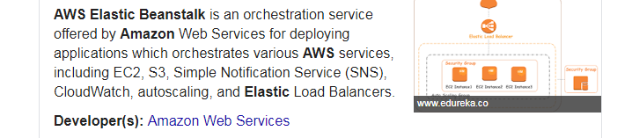

Slide 12
What Is Amazon EC2?
Amazon Elastic Compute Cloud (Amazon EC2) provides scalable computing capacity in the Amazon Web Services (AWS) cloud. Using Amazon EC2 eliminates your need to invest in hardware up front, so you can develop and deploy applications faster. You can use Amazon EC2 to launch as many or as few virtual servers as you need, configure security and networking, and manage storage. Amazon EC2 enables you to scale up or down to handle changes in requirements or spikes in popularity, reducing your need to forecast traffic.
What is a ec2 instance?
An EC2 instance is a virtual server in Amazon's Elastic Compute Cloud (EC2) for running applications on the Amazon Web Services (AWS) infrastructure. AWS is a comprehensive, evolving cloud computing platform; EC2 is a service that allows business subscribers to run application programs in the computing environment.

Slide 13
Amazon Route 53 (Route 53) is a scalable and highly available Domain Name System (DNS) service. ... The name is a reference to TCP or UDP port 53, where DNS server requests are addressed.
What is AWS Route 53 used for?
Amazon Route 53 is a highly available and scalable cloud Domain Name System (DNS) web service. ... Using Amazon Route 53 Traffic Flow's simple visual editor, you can easily manage how your end-users are routed to your application's endpoints—whether in a single AWS region or distributed around the globe.
1. Register domain names
2. Route internet traffic to the resources for your domain
3. Check the health of your resources

Slide 14
ACM (Certifiacte manager ) Provision,Manage and Deploy SSL/TLS certificates
To usethe AWS Management Console, navigate to the Certificate Manager, choose Request a certificate, select Request a public certificate, enter the domain name for your site, and follow the instructions on the screen to complete your request.
How do I get https on AWS?
To get your SSL certificate, simply go to the AWS Certificate Manager (ACM), which issues them for free.
1. Register SSL certificate through ACM.
2. Attach SSL certificate to EB Load Balance
Certificate Authorities, also known as CAs, issue certificates to specific domains. When a domain presents a certificate that is issued by a trusted CA, your browser or application knows it's safe to make the connection. ... AWS has been offering freecertificates to AWS customers from the Amazon Trust Services CA.

Slide 15
What is AWS RDS?
Amazon Relational Database Service (Amazon RDS) is a managed SQL database service provided by Amazon Web Services (AWS). Amazon RDS supports an array of database engines to store and organize data and helps with database management tasks, such as migration, backup, recovery and patching.
Amazon RDS is available on several database instance types - optimized for memory, performance or I/O - and provides you with six familiar database engines to choose from, including Amazon Aurora, PostgreSQL, MySQL, MariaDB, Oracle Database, and SQL Server. You can use the AWS Database Migration Service to easily migrate or replicate your existing databases to Amazon RDS.
How does AWS RDS works?
Amazon RDS makes it easy to control network access to your database. AmazonRDS also lets you run your database instances in Amazon Virtual Private Cloud (Amazon VPC), which enables you to isolate your database instances and to connect to your existing IT infrastructure through an industry-standard encrypted IPsec VPN

Slide 16
DB Instances
The basic building block of Amazon RDS is the DB instance. A DB instance is an isolated database environment in the cloud. A DB instance can contain multiple user-created databases, and you can access it by using the same tools and applications that you use with a stand-alone database instance. You can create and modify a DB instance by using the AWS Command Line Interface, the Amazon RDS API, or the AWS Management Console.
Each DB instance runs a DB engine. Amazon RDS currently supports the MySQL, MariaDB, PostgreSQL, Oracle, and Microsoft SQL Server DB engines. Each DB engine has its own supported features, and each version of a DB engine may include specific features. Additionally, each DB engine has a set of parameters in a DB parameter group that control the behavior of the databases that it manages.

Slide 17
What Is Amazon VPC?
Amazon Virtual Private Cloud (Amazon VPC) enables you to launch AWS resources into a virtual network that you've defined.
Amazon VPC is the networking layer for Amazon EC2.
A virtual private cloud (VPC) is a virtual network dedicated to your AWS account. It is logically isolated from other virtual networks in the AWS Cloud. You can launch your AWS resources, such as Amazon EC2 instances, into your VPC. You can specify an IP address range for the VPC, add subnets, associate security groups, and configure route tables.
A subnet is a range of IP addresses in your VPC. You can launch AWS resources into a specified subnet. Use a public subnet for resources that must be connected to the internet, and a private subnet for resources that won't be connected to the internet. For more information about public and private subnets.
To protect the AWS resources in each subnet, you can use multiple layers of security, including security groups and network access control lists (ACL).

